Slide 1
PHD Progression 7
Explainable AI with Visual analytics

Slide 2
Uploading visbert and attentionviz to gitHUB
Error message pushing to GitHub
Due to file size, I’ve tried to reduce size with no success so far
$ git push -u origin main Enumerating objects: 373, done. Counting objects: 100% (373/373), done. Delta compression using up to 4 threads Compressing objects: 100% (149/149), done. error: RPC failed; HTTP 408 curl 22 The requested URL returned error: 408 send-pack: unexpected disconnect while reading sideband packet Writing objects: 100% (373/373), 978.31 MiB | 6.11 MiB/s, done. Total 373 (delta 203), reused 360 (delta 198), pack-reused 0 fatal: the remote end hung up unexpectedly Everything up-to-date

Slide 3
^{Understanding the visBERT code}
Spent time breaking down the VisBERT code to understand what each part of the code does
Visualize: contains the dimensionality reduction function
Utils: contains functions for event time logging and conversion from web data to normal text
Data utils: This is the SQUAD dataset loader and processor for question-answering tasks, designed for BERT-like transformer models

Slide 4
Changing the document input for visBERT
I tried changing the squad_examples.json for the VisBERT data set with other SQUAD question answer examples I found online.
I copied pasted and ran the code on new examples, the code ran but the SQUAD portion was inactive.
Bin files for model fine-tuning disappeared and had to be redownloaded when VisBERT was stopped

Slide 5
^{DATa preparation}
After comparisons were made of the SQUAD dataset found online and that of VisBERT, I noticed they were formatted differently
This means the data was clean for the purpose of this task
SQUAD example in VisBERT only requires context, question, id, and answer
Cleaning the Data set and trying the process again

Slide 6
Hugging face for transformers and finetuning
Both VisBERT and AttentionVIZ contain some sort of data or model file which is required for the systems to run on my system, after running, it creates json files.
Downloaded bin file in VisBERT and AttentionViZ are pretrained model finetuned on hugging face, containing attention weights and parameters required for visualization

Slide 7
AttentionVIZ
The goal of this study is to understand the self-attention mechanism of transformers
previous techniques generally visualize information related to just a single input sequence at a time.
The primary technique of this research is visualizing a joint embedding of the query and key vectors used by transformers.

Slide 8
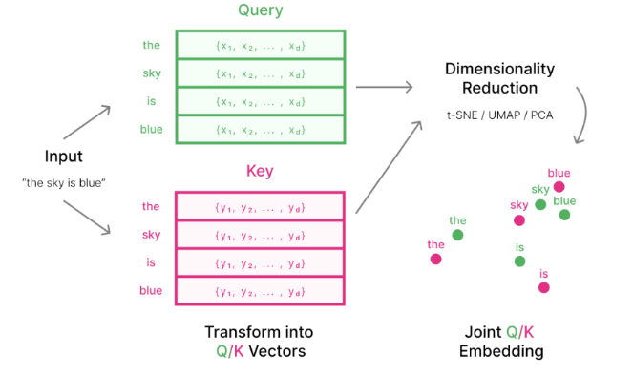

AttentionVIZ
An effective method to visualize multiple inputs is to visualize a collection of embedded vectors from multiple input sequences.
Each attention transformer head turns input embedding into query vectors and key vectors by applying matrices $W_{Q} and W_{K}$
These matrices then project the vector embedding to a lower dimensional space, getting only specific information from the higher-dimensional vector embedding

Slide 9
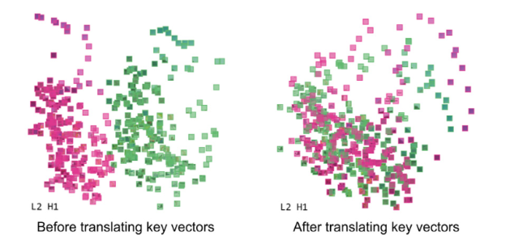
AttentionVIZ
attention coefficients depend on the dot product between queries and keys; Closer distance directly shows higher attention coefficients.
the relationship between dot product and distance is not precise, as query and key vary in norm
Vector normalization is applied prior to dimensionality reduction; this is to tune the ‘2 free parameters’ and create a closer relationship between embedding distance and attention weights

Slide 10
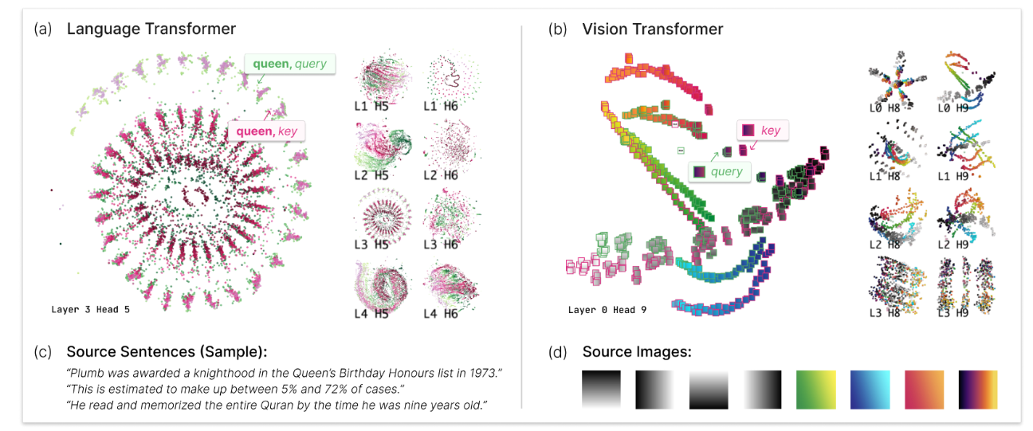
AttentionVIZ
we obtain the key and query vector representation of each token in each sentence, then use dimensionality reduction techniques such as t-SNE, UMAP or PCA to project the high-dimensional vector into low-dimensional space.
This attentionVIZ is used for language and vision transformers
It's important to note that each dimensionality reduction technique will produce different patterns.

Slide 11
AttentionVIZ: vector normalization
Key translation: Due to separation between query and key vectors, we make use of the soft max function to resolve this, this causes key and query to have common centroid
Attentionj(x) = softmax j((x,y1),(x,y2),….)
= softmax j((x,y1)+(x,v),(x,y2)+(x,v),….)
= softmax j((x,y1+v),(x,y2+v),….)
Scaling Queries and Keys: In GPT-2 average query norm was different to average key norm( query were tiny clusters and keys were loose clouds) Scale query by C != 0 and key by C^(-1)

Slide 12

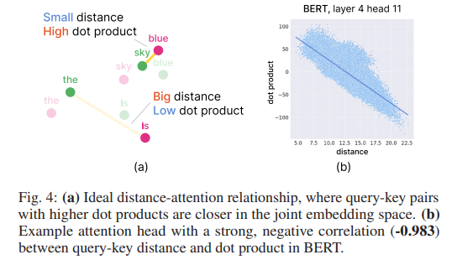
AttentionVIZ: Dot product vs distance

Slide 13
AttentionVIZ: views and interactivity
Attentionviz offers various color customizations for token types (key or query). For vision transformers, users can color by image patch row or column to visualize positional patterns. For language models, color options are normalized and discrete.
This research framework provides three interactive views, Matrix view, single view, and sentence/Image view.

Slide 14
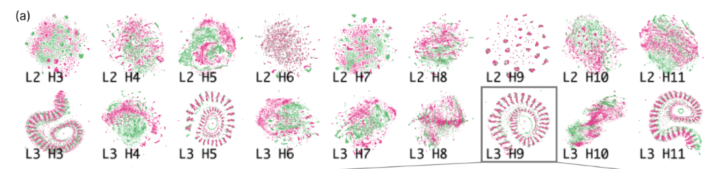
AttentionVIZ: views and interactivity
Matrix view uses small multiples to visualize the attention heads in the transformer at once.
Each row corresponds to a model layer.
This provides a Global perspective that users can easily scan for patterns across different transformer layers and heads.

Slide 15
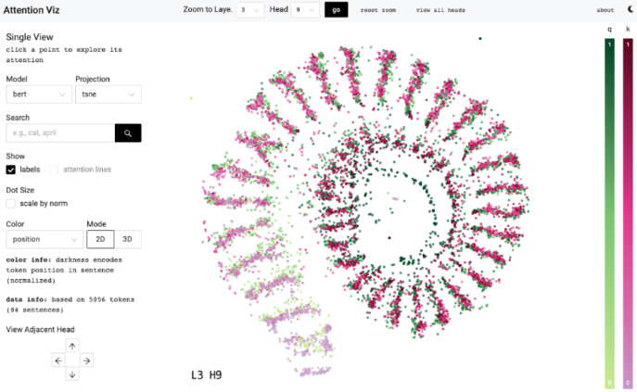
AttentionVIZ: views and interactivity
Single view, any plot in the matrix view can be clicked on to zoom into a single view, which allows the exploration of a single attention head in closer detail.
It allows for the same customizations available in Matrix view.
Users also have the option to project attention lines onto the scatterplots, which connect query and key tokens, and show only the top two attention weights for readability.

Slide 16
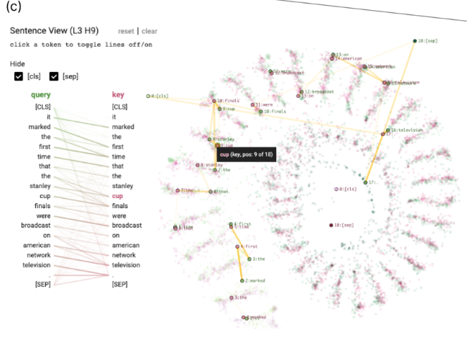
AttentionVIZ: views and interactivity
Sentence view: When using BERT or GPT-2 users can click on a point in single view to open sentence view in the left sidebar,
which displays BertViz-inspired visualization of sentence-level attention with the clicked token highlighted, bipartite approach offers the best readability.
The opacity of connecting query tokens to key tokens shows the strength of attention.
Hovering over a token highlights a token-specific attention line. To reduce noise from classification tokens and separators, attention lines can be hidden.

Slide 17
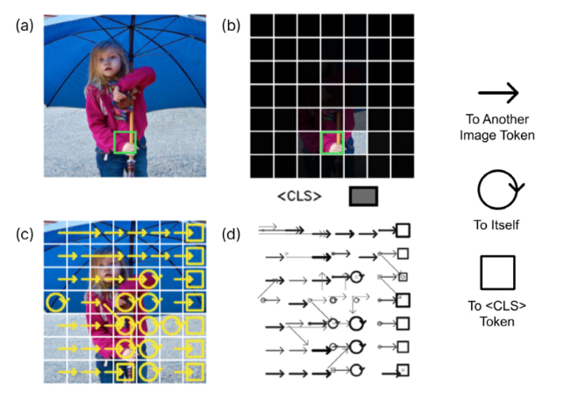
AttentionVIZ: views and interactivity
Image view: For image-based input in ViT, when an image patch is clicked on, the clicked token is highlighted with colored border, users also see an image overlaid with an attention heatmap
The overall attention pattern within an image can also be explored by showing arrowed lines between different image patches.
There are two options available for visualizing attention arrows; the first option overlays heatmap on the top of the original image patches, with transparency indicating the attention weight between clicked image patch and other regions.
The second option shows the attention pattern of the whole image.

Slide 18
AttentionVIZ: Findings and Evaluation
Experts in the field were invited to evaluate the tool and its results
We were curious if any visual attention heads specialize in either color-based and brightness-based patterns. PCA patterns in the matrix view, showed two attention heads that resemble color and colorless vision
Tokens pay the most attention to other tokens with the same color or brightness

Slide 19
AttentionVIZ: Findings and Evaluation
They identified an attention head that separates image tokens based on their spatial pattern’s frequencies and angles (similar shapes and angles paid attention to each other).
Self attention attends more broadly across images in deeper layers of vision transformers
Unlike CNN which processes images using square filter, the self-attention mechanism in transformers often processes images row by row and column by column, analogous to an elongated filter.

Slide 20
AttentionVIZ: Findings and Evaluation
They identified in the global view of TSNE that plots with spirals and clump tokens encode positional patterns; token position increases as we move from the outside to the inside of the spiral.
The difference between spirals and clumps appear to be whether token attends selectively to others one position away, vs several different positions
Heads with high query-key overlap. Tokens typically attend to themselves and other instances of the same token

Slide 21
AttentionVIZ: Findings and Evaluation
Earlier layers have more have the most information about linear word order
Mid-to-later model layers contains syntactic and task-specific information; for instance, later layers have query-key sandwich, where keys and queries at the beginning of text are stacked, followed by being in reverse order at the end of the text.

Slide 22
AttentionVIZ: Findings and Evaluation
An overview of the TSNE global search pattern shows that patterns in clumps and spirals have more dispersed search results, indicative of their underlying positional attention patterns.
Heads with the “look at self” attention pattern only have one cluster of search results, emphasizing the strong interaction between query and keys
Even when there was no distinctive shape, if there were a few search result clusters, the head may display more semantic behavior.

Slide 23
AttentionVIZ: identifying anomalies and unexpected Behaviour
In GPT-2 they noticed large disparity in the norm of query and key, there was no explanation for this, how ever a paper published points to out-of-control query and key norms as cause of training instability.
In many GPT-2 heads, attention was mostly directed to the first token, especially in the later layers
Self attending attention heads

Slide 24
AttentionVIZ: Future works
generalized to other attention mechanism e.g., cross attention, with modifications to vector normalization.
Focusing on syntactic features e.g. NLP libraries to add metadata such as part of speech

Slide 25
AttentionVIZ: Future works
finding ways to manage the complexity of multiple embedding visualizations and focus users on features of interest.
Another natural direction for future research is exploring how to incorporate information from value vectors in each attention head.

Slide 26
Supervisors Feedback
Create your own LLM to understand how they work
Make small versions of the explainable visualizations
Play around with D3.Js and watch how the frontend interacts with the back end.

